Slide 1
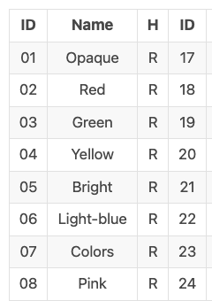
Datasets
Argentanian Sign Language Dataset (Video Data)
includes 3200 videos
10 non-expert subjects executed 5 repetitions of 64 different types of signs
Signs were selected among the most commonly used ones in the LSA lexicon
Some signs are single handed and others using both hands
For our experiment we use only eight signs using the right hand
Notes:
Handcrafted feature data set

Slide 2
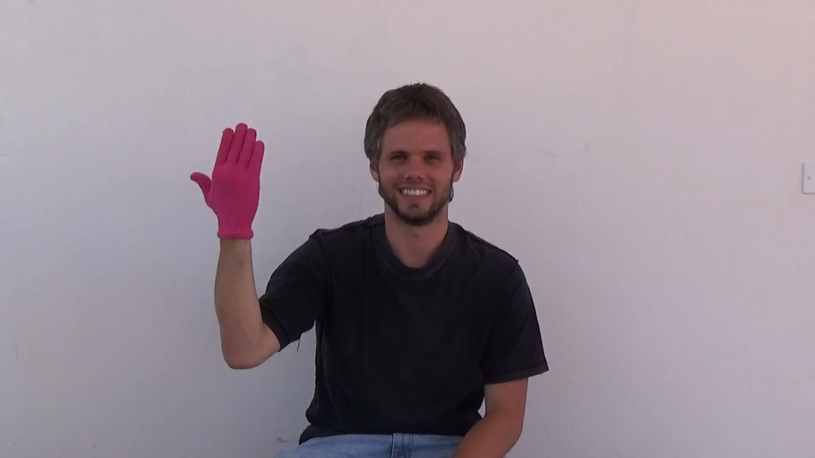
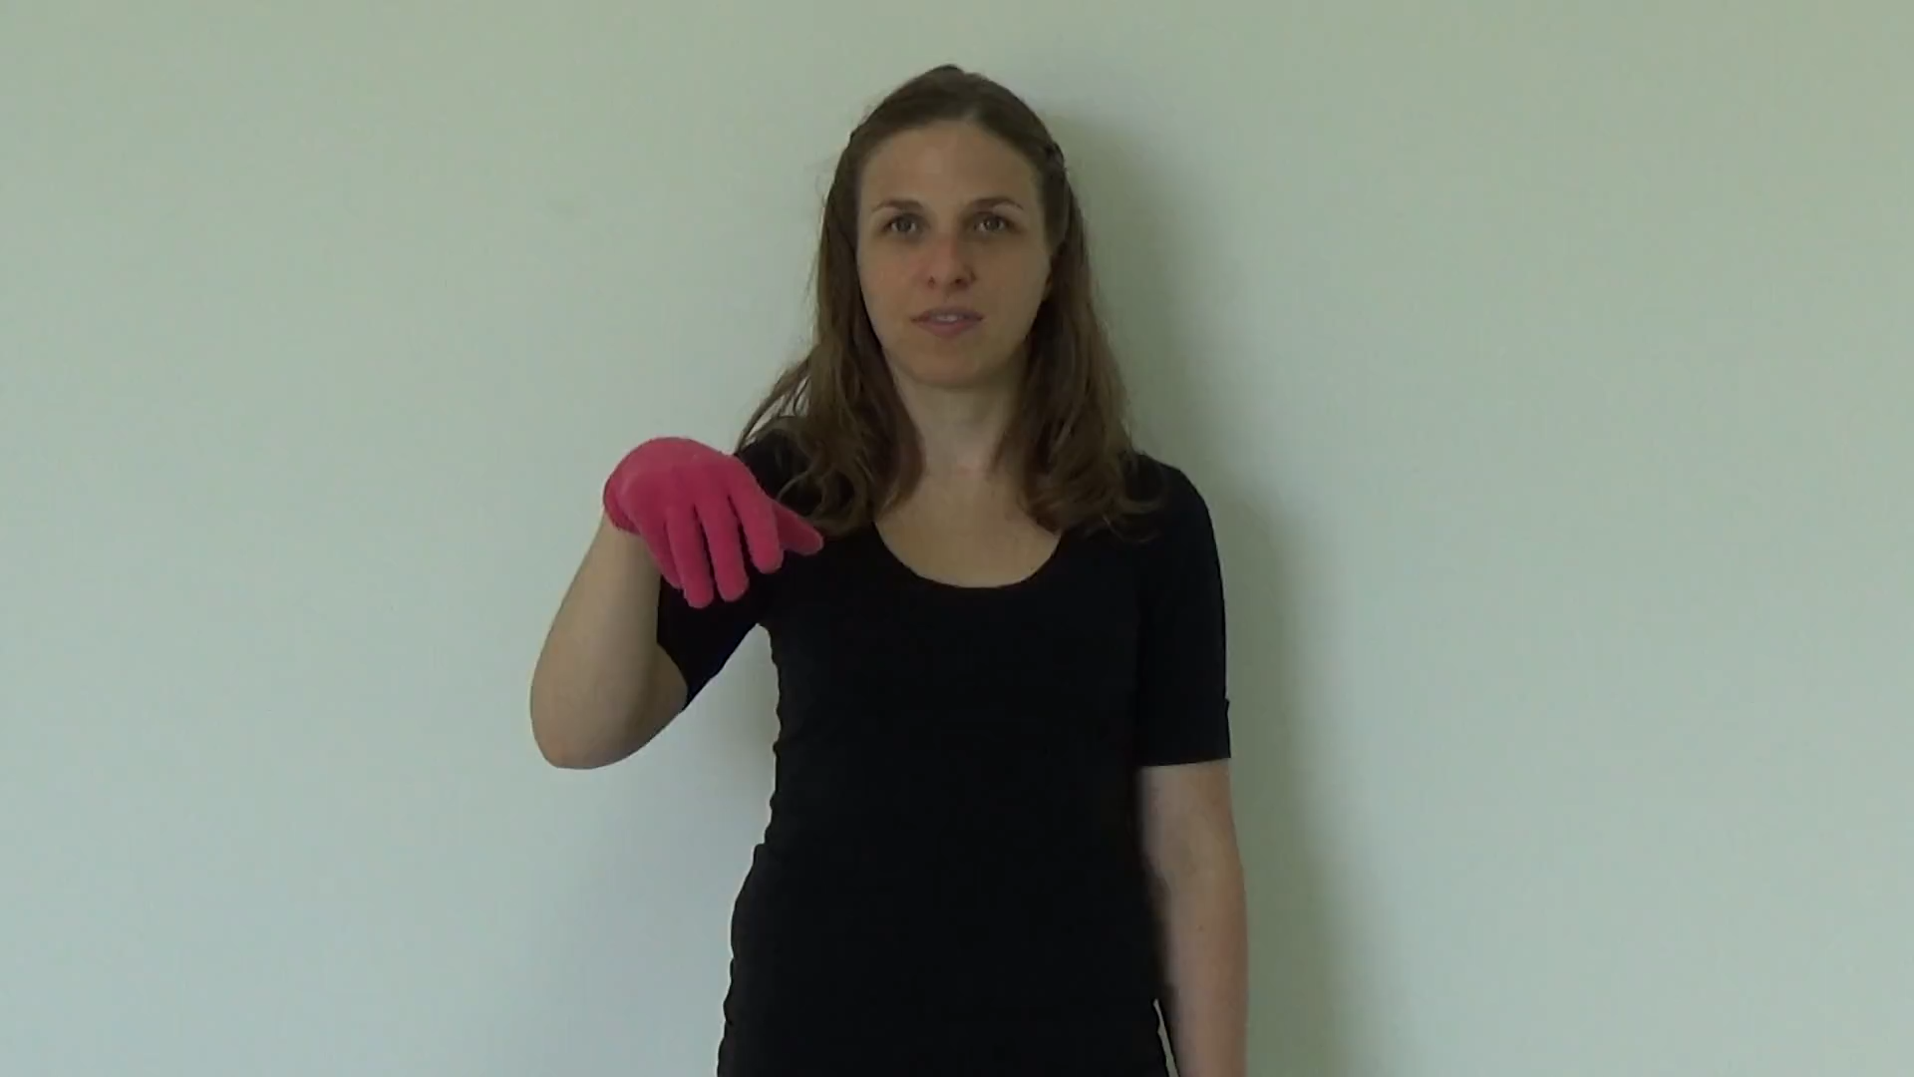
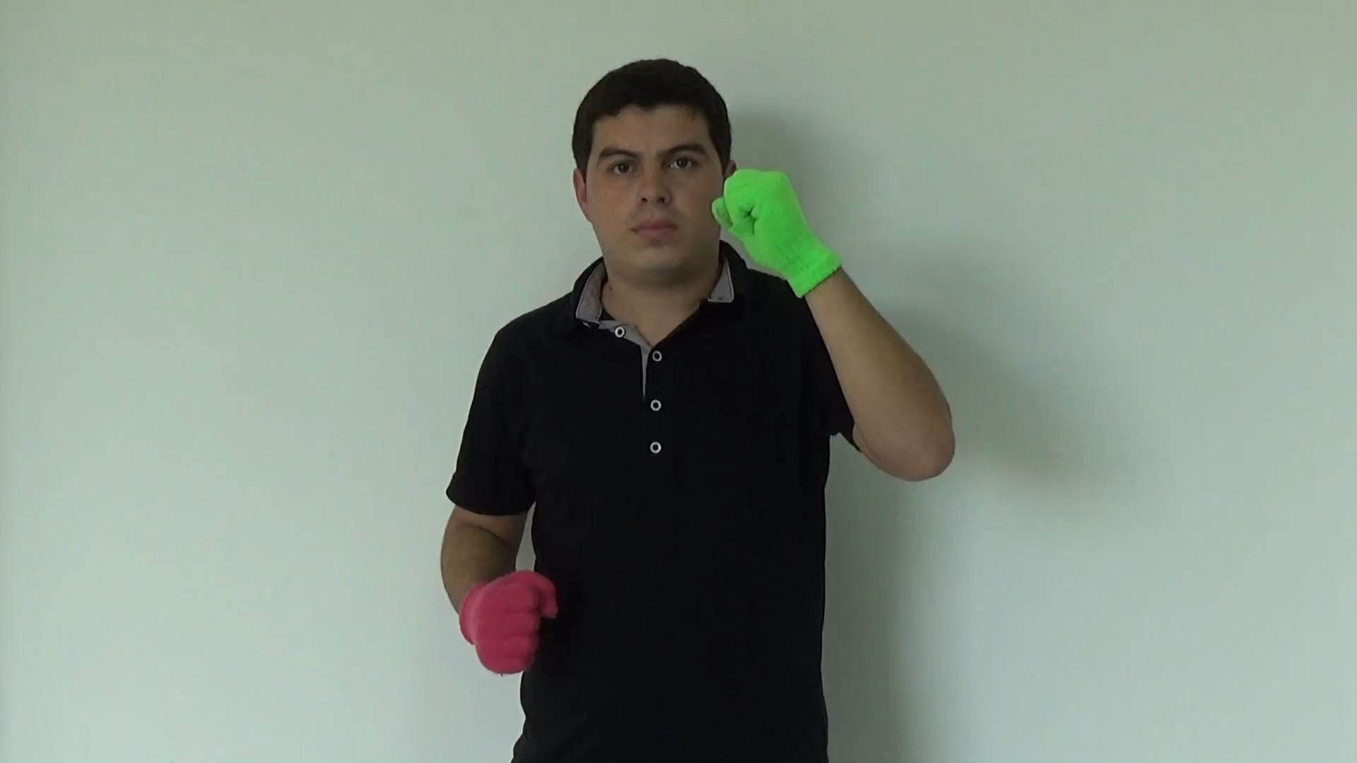
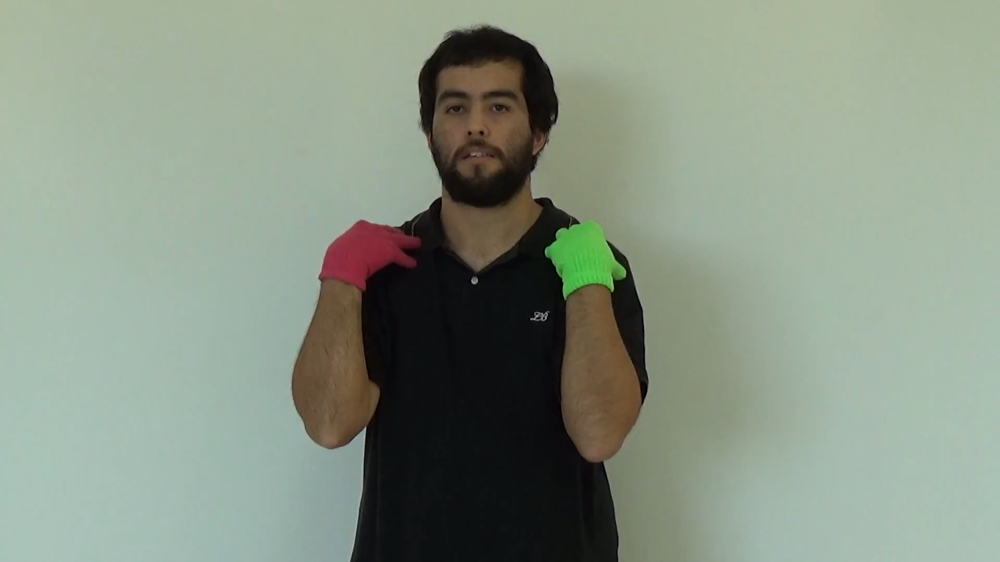
Sign Language Dataset – Sample Videos
Notes:
Other than these 192 feature space ,we keep track of below features too
['VIDEO_ID', 'USER_ID', 'ITERATION', 'FRAME_SQ_NUMBER', 'TIMESTAMP', 'CURRENT_POS_AVI_RATIO', 'HANDEDNESS']

Slide 3
Pre-processing
Basis : Argentanian Sign Language Dataset (Video Data)
Dataset 1 :
Contains angles and distance measures of two hands
Feature space : (56,)
# 15 angles for each hand
# 9 distance measures for each hand
# 6 body angles
# 2 body distance measures
Do we loose the definition of graph structure? hard to constraint the ownership of angle to a single node
Introducing artificial edges and nodes to define new features
ex: distance measures between tips
Notes:
Handcrafted feature data set

Slide 4
Datasets
Basis : Argentanian Sign Language Dataset (Video Data)
Dataset 2 :
Contains coordinates of hand and body joints
Contains speed of each joint
Each joint contains four features (x,y,z,speed)
Feature space : (192,)
# 21 hand joints x 4 features
# 6 body joints x 4 features
four Other than above feature space we keep track on following features too
['VIDEO_ID', 'USER_ID', 'ITERATION', 'FRAME_SQ_NUMBER', 'TIMESTAMP', 'CURRENT_POS_AVI_RATIO', 'HANDEDNESS’, … ,’SIGN’]
Notes:
Other than these 192 feature space ,we keep track of below features too
['VIDEO_ID', 'USER_ID', 'ITERATION', 'FRAME_SQ_NUMBER', 'TIMESTAMP', 'CURRENT_POS_AVI_RATIO', 'HANDEDNESS']

Slide 5
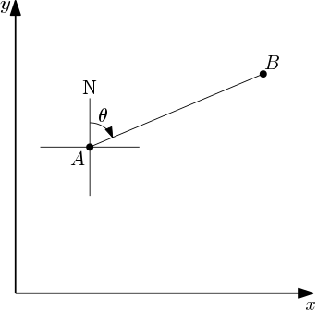
Datasets
Data set 2 extension : (proposed)
Instead of defining angle and distance measures ,
Get the bearing of each node relative to a given node
Since the distance is always a constant, bearing is a reliable measure
Node ordering is important. Ordering can be predefined
ex: Nodes appearing near to the CoG of the body
has a higher ordering
Notes:
Haven’t seen this approach in any literature

Slide 6
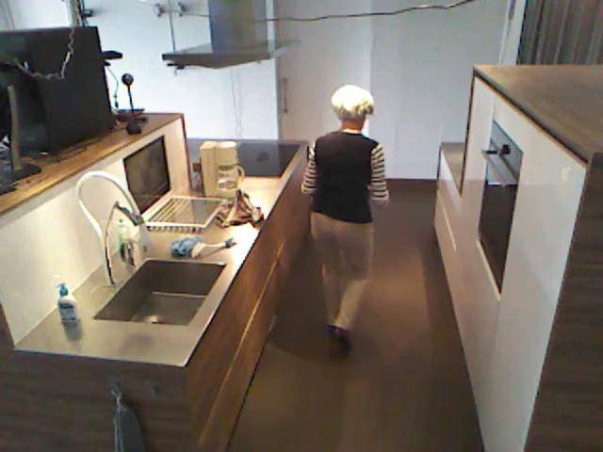
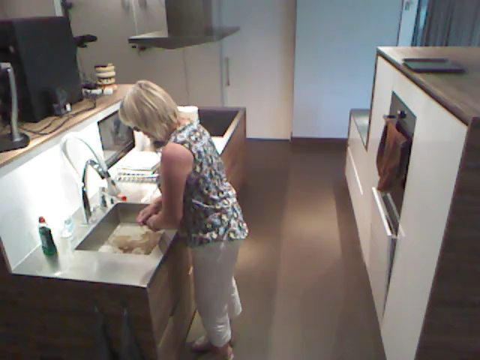
Toyota Smart home Dataset
Contains daily living activities of 18 subjects (Video data)
3 Modalities: RGB, Depth, 3D skeleton
31 different activities. (ex: eat, walk, cook.cleandishes, cook.cleanup)
16000 video data samples
Notes:
2 validation stratergies
Cross subject validation
Cross view validations
1.cook.cleanup
2.

Slide 7
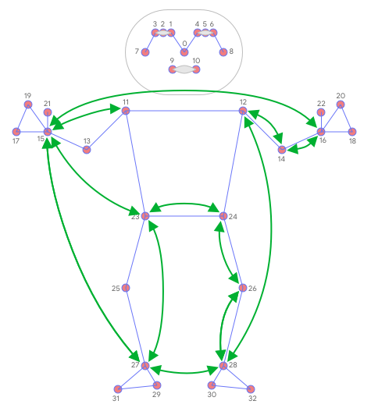
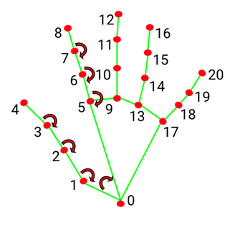
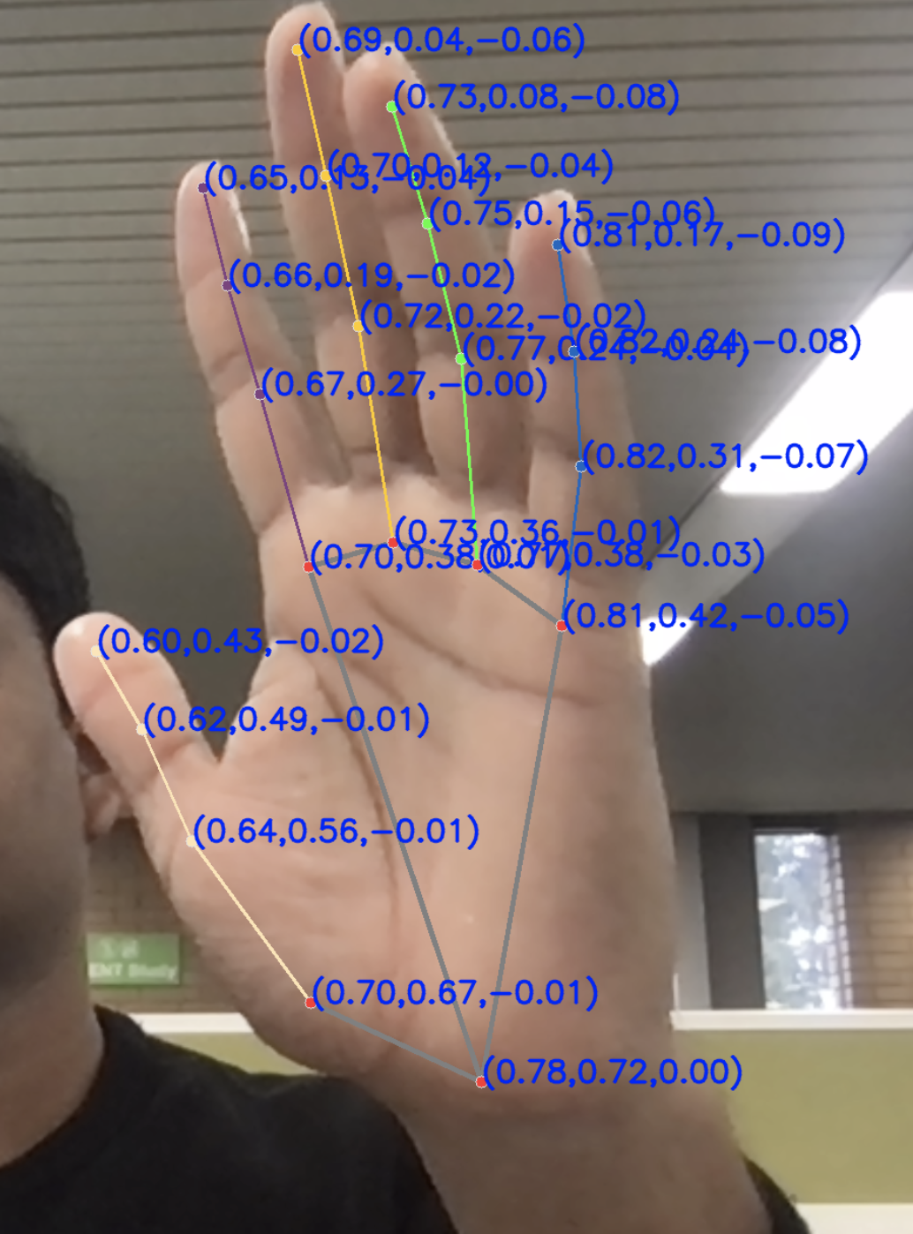
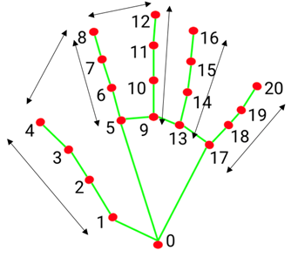
Datasets

Slide 8
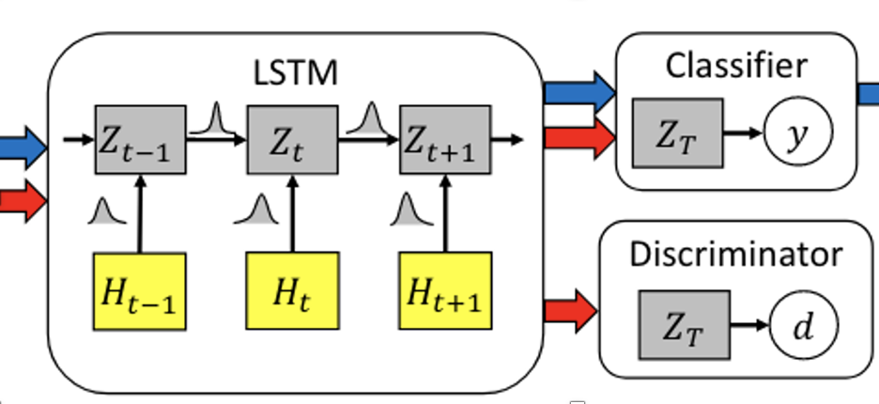
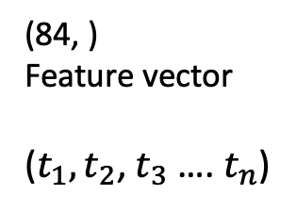
Spatio Temporal Modelling using LSTM network
Objective : Get a unique vector representation to characterise human gestures
Approach 1 : Modelling spatial aspect using hand joint features and modelling temporal aspect using LSTM
(84, )
Feature vector
($t_{1},t_{2}$, $t_{3}$ …. $t_{n}$)
Notes:
partitioning means the protocol on how to decide the neibourhood. rule for defining the neighbourhood receptive field
Analyse the confusion matrix

Slide 9
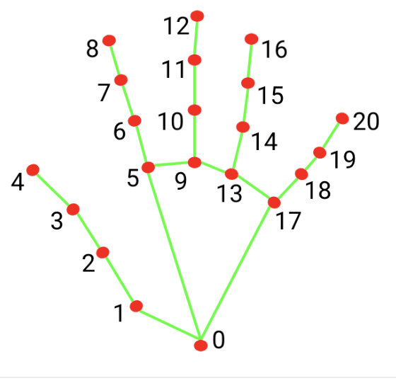
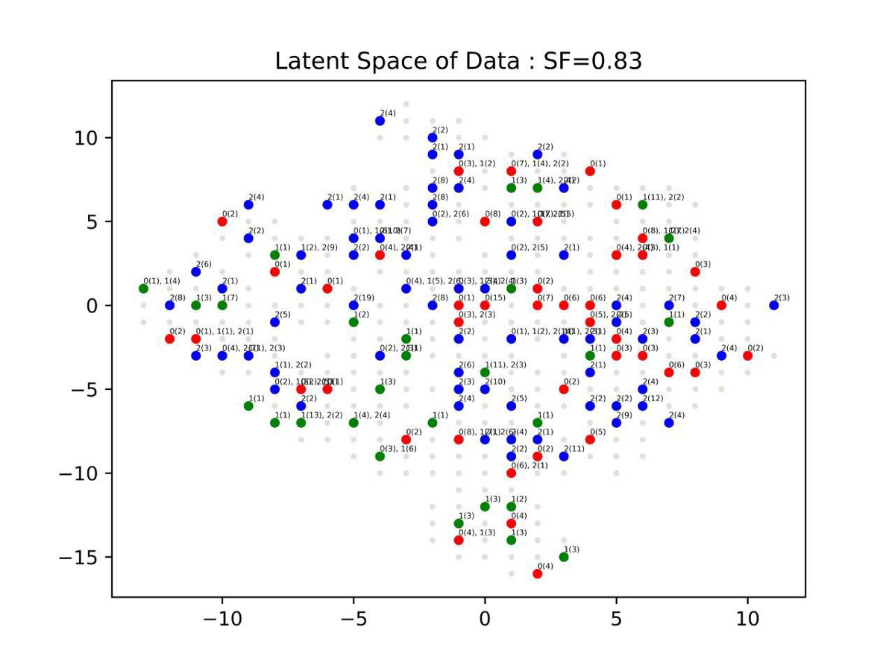
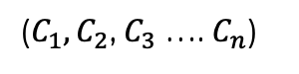
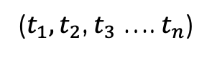
Network Architecture
Encoder Network
GCN Unit
(Cheb Conv/GCN Conv)
LSTM Unit
Fully Connected MLP Layer
Softmax Layer
(Supervised)
Classification
($C_{1},C_{2}$, $C_{3}$ …. $C_{n}$)
Sign Language Video Dataset
($t_{1},t_{2}$, $t_{3}$ …. $t_{n}$)
GSOM
(Unsupervised)
Notes:
Refer https://ieeexplore.ieee.org/stamp/stamp.jsp?arnumber=9253716

Slide 10
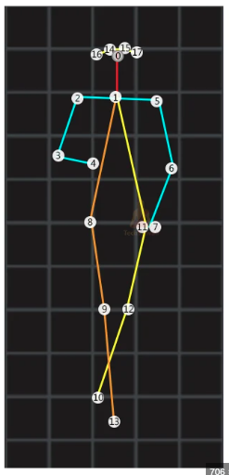
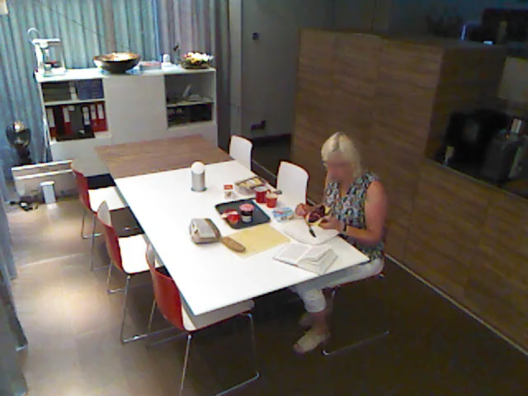
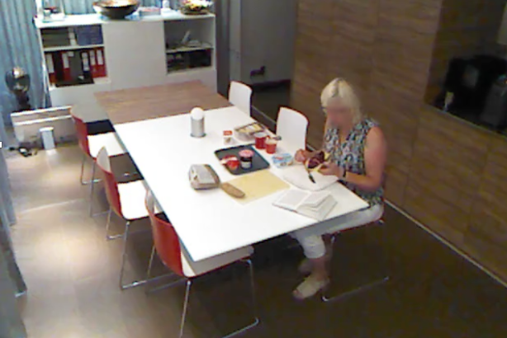
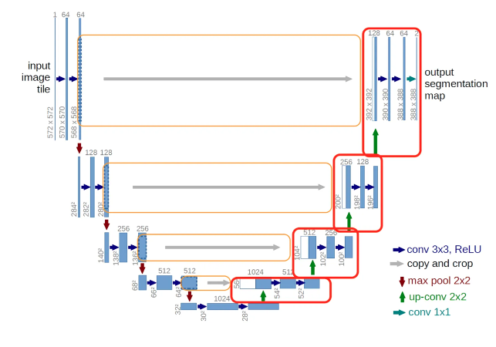
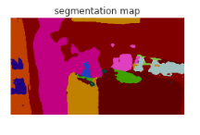
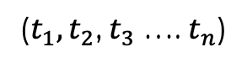
Network Architecture
Encoder Network
GCN Unit
(Cheb Conv/GCN Conv)
LSTM Unit
Fully Connected MLP Layer
Softmax Layer
(Supervised)
Classification
($C_{1},C_{2}$, $C_{3}$ …. $C_{n}$)
Smart home Video Dataset
($t_{1},t_{2}$, $t_{3}$ …. $t_{n}$)
Encoder Network
RNN Unit
($t_{1},t_{2}$, $t_{3}$ …. $t_{n}$)
U Net with attention mechanism
Notes:
Refer https://ieeexplore.ieee.org/stamp/stamp.jsp?arnumber=9253716
Next improvement
Identify behavioural features
Model video into a dynamic graph representation
Anomaly detection

Slide 11
Network Architecture
Encoder Network
GCN Unit
(Cheb Conv/GCN Conv)
LSTM Unit
Fully Connected MLP Layer
Softmax Layer
(Supervised)
Classification
($C_{1},C_{2}$, $C_{3}$ …. $C_{n}$)
Smart home Video Dataset
($t_{1},t_{2}$, $t_{3}$ …. $t_{n}$)
Encoder Network
ResNet Unit
Fully Connected MLP Layer
Fully Connected MLP Layer
($t_{1},t_{2}$, $t_{3}$ …. $t_{n}$)
Context Encoding Mechanism
Notes:
Refer https://ieeexplore.ieee.org/stamp/stamp.jsp?arnumber=9253716
Next improvement
Identify behavioural features
Model video into a dynamic graph representation
Anomaly detection

Slide 12
Proposed Architecture
Encoder Network
AGCN Unit
(Cheb Conv/GCN Conv)
AGCN Unit
(Cheb Conv/GCN Conv)
LSTM Unit
Fully Connected MLP Layer
Softmax Layer
(Supervised)
Classification
($C_{1},C_{2}$, $C_{3}$ …. $C_{n}$)
Smart home Video Dataset
($t_{1},t_{2}$, $t_{3}$ …. $t_{n}$)
n = 7 layers
GSOM
(Unsupervised)
ResNet Unit
Fully Connected MLP Layer
Fully Connected MLP Layer
($t_{1},t_{2}$, $t_{3}$ …. $t_{n}$)
Context Encoding Mechanism
Notes:
Refer https://ieeexplore.ieee.org/stamp/stamp.jsp?arnumber=9253716
Next improvement
Identify behavioural features
Model video into a dynamic graph representation
Anomaly detection

Slide 13
Network Architecture
Encoder Network
AGCN Unit
(Cheb Conv/GCN Conv)
AGCN Unit
(Cheb Conv/GCN Conv)
LSTM Unit
Fully Connected MLP Layer
Softmax Layer
(Supervised)
Classification
($C_{1},C_{2}$, $C_{3}$ …. $C_{n}$)
Smart home Video Dataset
($t_{1},t_{2}$, $t_{3}$ …. $t_{n}$)
n = 7 layers
GSOM
(Unsupervised)
RGB Modality
Accelerometer data
($t_{1},t_{2}$, $t_{3}$ …. $t_{n}$)
Depth info etc.
Notes:
Refer https://ieeexplore.ieee.org/stamp/stamp.jsp?arnumber=9253716
Next improvement
Identify behavioural features
Model video into a dynamic graph representation
Anomaly detection

Slide 14
Novelty: Why this model?
Spatial and temporal aspects are handled separately in different components
The proposed architecture allows the fusing of different modalities of data with a similar frequency
Accelerometer data

Slide 15
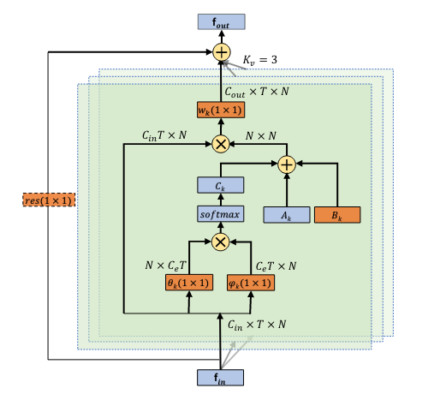
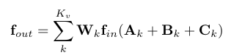
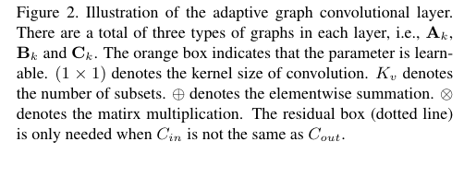
Concept of Adaptive GCN
Adjacency metric is dynamic and changes depending on the data

Slide 16
 |  | AGCN Model | AGCN model (without temporal convolution) | GCN + LSTM | GCN + RGB + LSTM Proposed Architecture
Epoch 1 | Top 1 | 30.13 | 33.26 | 22.77 | 22.7
 | Top 5 | 67.27 | 71.89 | 56.58 | 56.58
Epoch 2 | Top 1 | 38.27 | 41.98 | 31.95 | 37.62
 | Top 5 | 74.73 | 78.80 | 64.18 | 76.77
Epoch 3 | Top 1 | 42.70 |  | 51.43 | 51.48
 | Top 5 | 79.20 |  | 84.70 | 85.61
Epoch 30 | Top 1 |  |  |  | 61.46
 | Top 5 |  |  |  | 91.48

Slide 17
Model performance
 |  | Cross Subject | Cross View 1 | Cross view 2
Smart home dataset | Top 1 | 61.46 | 37.27 | 65.53
 | Top 5 | 91.48 | 79.09 | 94.07
NTU-RGB- 60
NTU-RGB-120
N-UCLA

Slide 18
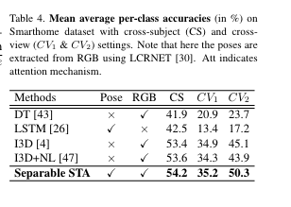
State of the art performance
Ref :Toyota Smarthome: Real-World Activities of Daily Living
https://www.researchgate.net/publication/337316196_Toyota_Smarthome_Real-World_Activities_of_Daily_Living

Slide 19
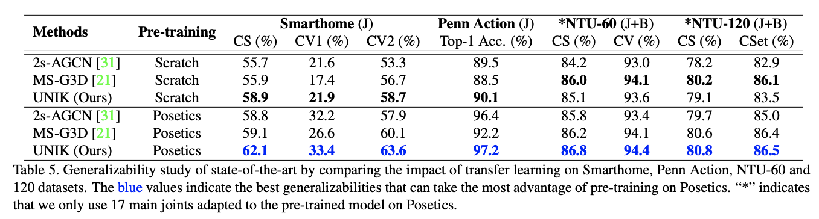
State of the art performance
Ref :UNIK: A Unified Framework for Real-world Skeleton-based Action Recognition
https://arxiv.org/pdf/2107.08580.pdf

Slide 20
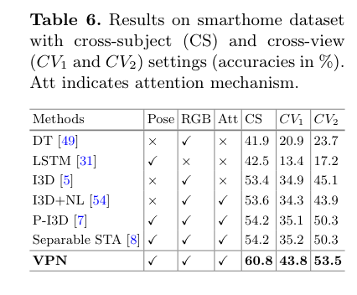
State of the art performance
Unik |  |  |  | 58.9
Our Model |  |  |  | 61.4
Ref :PN: Learning Video-Pose Embedding for Activities of Daily Living
https://arxiv.org/abs/2007.03056. (2020)

Slide 21
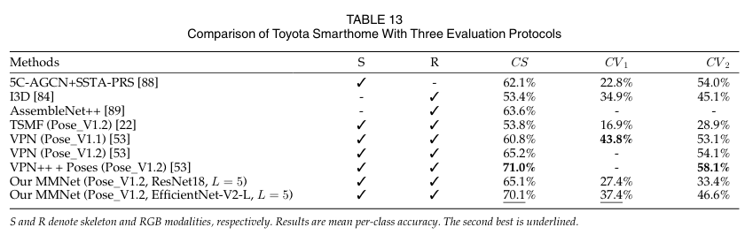
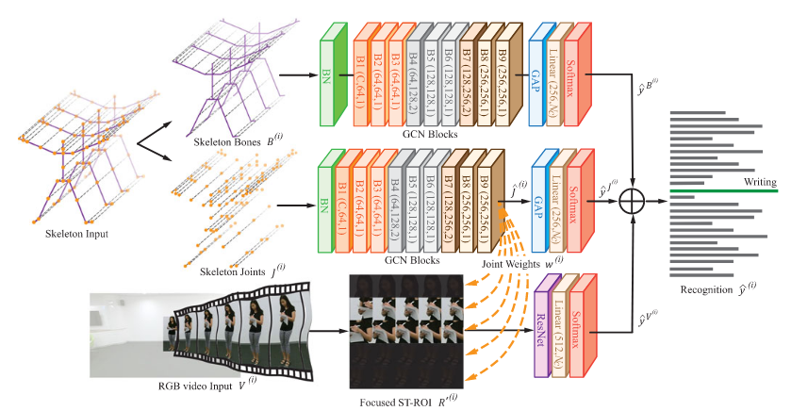
State of the art performance
Ref :MMNet: A Model-Based Multimodal Network for Human Action Recognition in RGB-D Videos
https://ieeexplore.ieee.org/document/9782511
Notes:
Model-based multimodal methods address multimodal HAR at the model level, which is consistent with the concept of co-learning [18] and represents a kind of fusion method. Model-based fusion differs from typical fusionbased methods such as feature- and decision-level fusion, which respectively correspond to the concatenating and adding operations of model-agnostic fusion methods. Our model-based fusion approach is also unique from existing model-level fusion methods that require representation similarity among different modalities. Specifically, our MMNet addresses fusion with co-learning based on a comprehensive understanding of the data structure; specifically, we learned representation from the RGB modality by focusing on body areas that brought mutually complementary features to the skeleton modality.

Slide 22
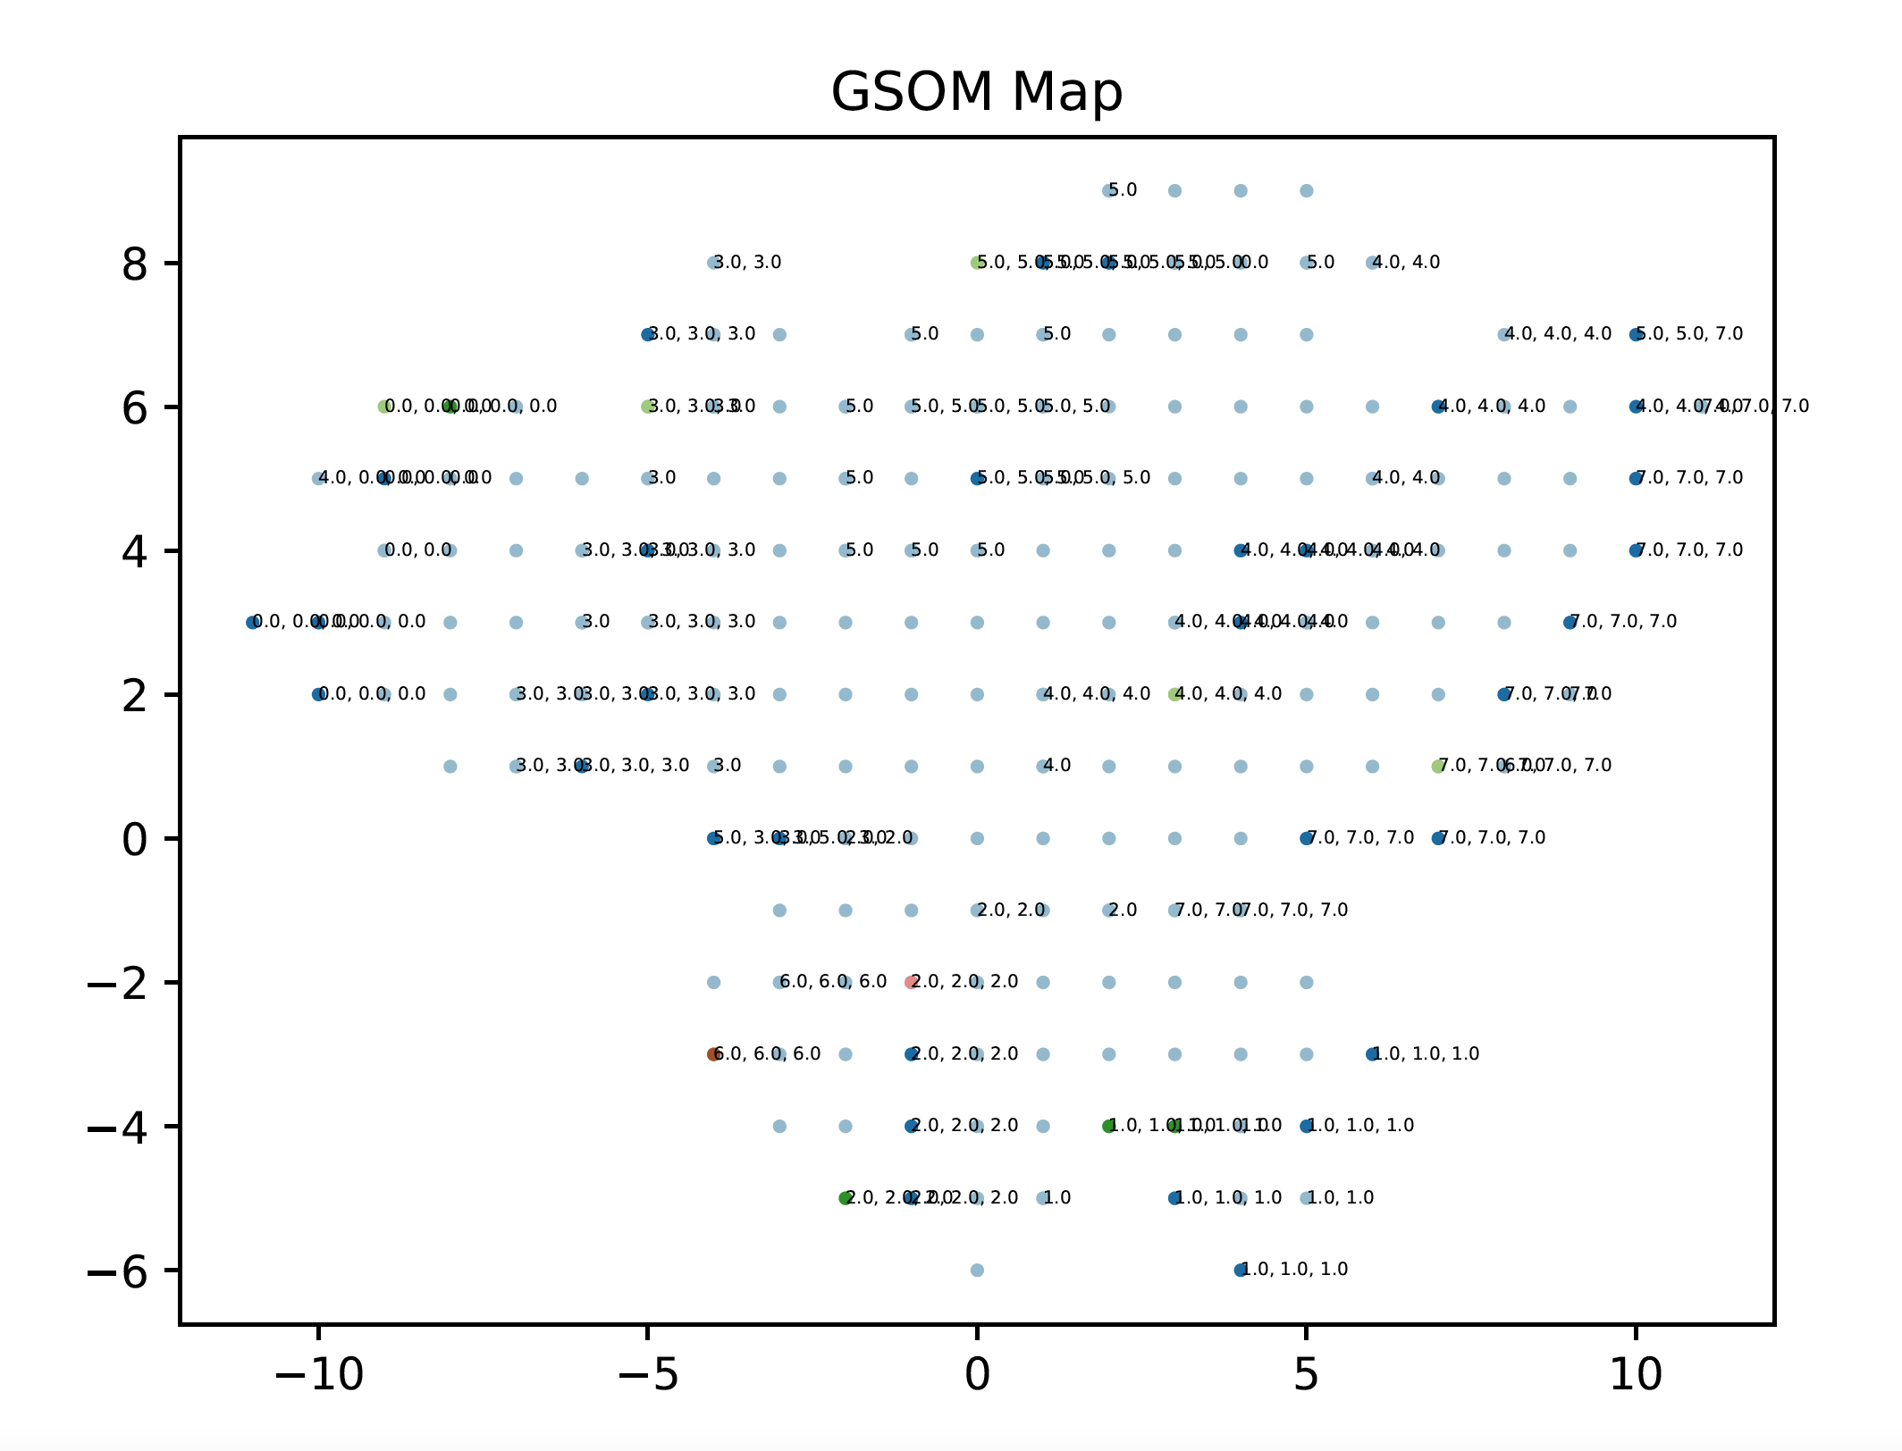
Results - GSOM

Slide 23
Extensions
Extend classification task to a auto encoder
follow encoder decoder architecture
challenge : a. define deconvolution method for GCN
b. should use pure GCN for both spatial and temporal feature modelling(3d GCN , used in ST-GCN paper)
c. can use U-Net architecture
Use another data set
CMU data set (motion capture data)
Potential other experiments?
How to measure the cluster purity in GSOM/ evaluate quality of GSOM output
Topic
Semi-supervised neural network for video classification using graph convolution
Notes:
One way to perform general graph convolution is derived from spectral graph theory [30], which allows the graph convolution to be carried out in the spectral domain. The key operation is computing the graph Fourier transform, which is equivalent to computing an expansion of the graph with respect to the eigenfunctions of the graph Laplacian. Defferrard et al. [15] proposed to use an efficient approximation to compute the graph Fourier transform based on the Kth-order Chebyshev polynomial.
L = D-A
L is the bridge between the graph representation and the Linear algebra

Slide 24
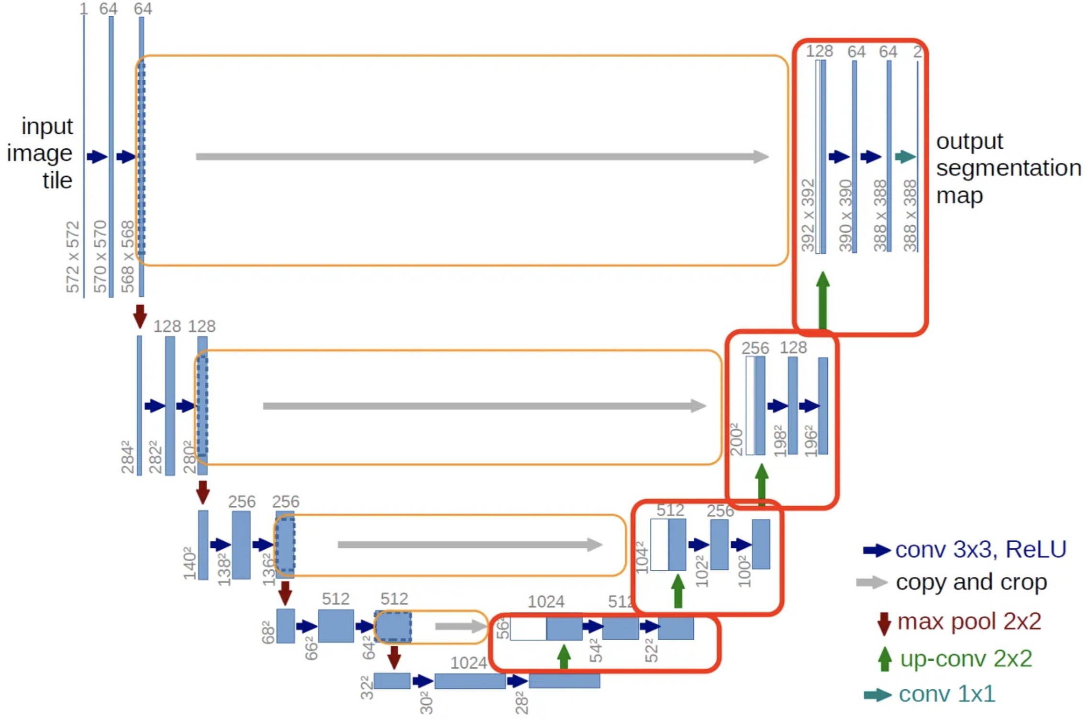
U net Architecture
Notes:
One way to perform general graph convolution is derived from spectral graph theory [30], which allows the graph convolution to be carried out in the spectral domain. The key operation is computing the graph Fourier transform, which is equivalent to computing an expansion of the graph with respect to the eigenfunctions of the graph Laplacian. Defferrard et al. [15] proposed to use an efficient approximation to compute the graph Fourier transform based on the Kth-order Chebyshev polynomial.
L = D-A
L is the bridge between the graph representation and the Linear algebra

Slide 25
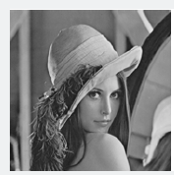
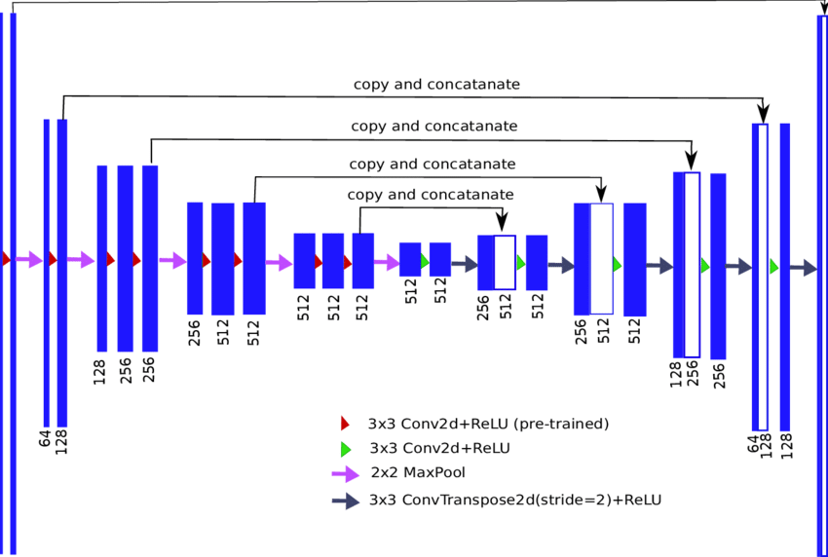
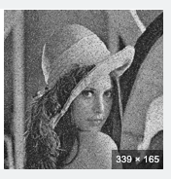
Encoder Decoder Architecture
Notes:
One way to perform general graph convolution is derived from spectral graph theory [30], which allows the graph convolution to be carried out in the spectral domain. The key operation is computing the graph Fourier transform, which is equivalent to computing an expansion of the graph with respect to the eigenfunctions of the graph Laplacian. Defferrard et al. [15] proposed to use an efficient approximation to compute the graph Fourier transform based on the Kth-order Chebyshev polynomial.
L = D-A
L is the bridge between the graph representation and the Linear algebra

Slide 26
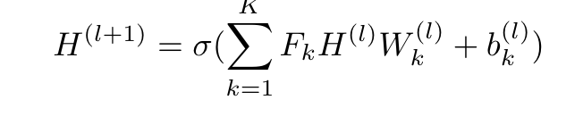
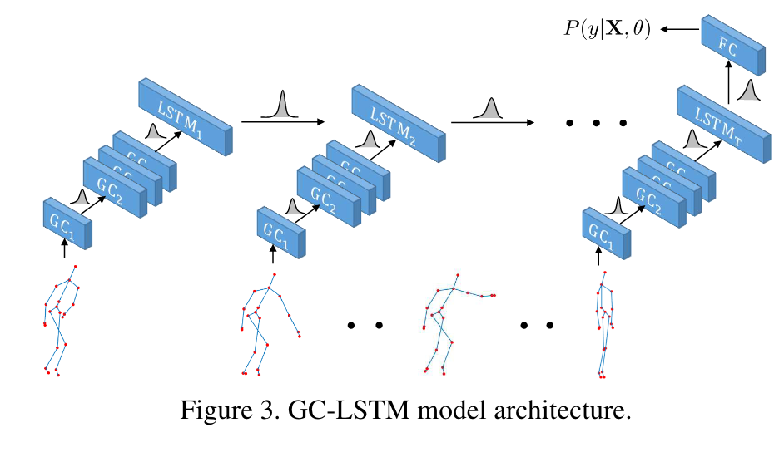
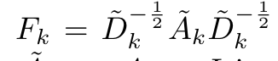
Spatio Temporal Modelling
Approach 2 : Getting the frame representation using GNN
Methods : 1. Obtaining global graph representation using Graph Spectral Theory
Notes:
One way to perform general graph convolution is derived from spectral graph theory [30], which allows the graph convolution to be carried out in the spectral domain. The key operation is computing the graph Fourier transform, which is equivalent to computing an expansion of the graph with respect to the eigenfunctions of the graph Laplacian. Defferrard et al. [15] proposed to use an efficient approximation to compute the graph Fourier transform based on the Kth-order Chebyshev polynomial.
L = D-A
L is the bridge between the graph representation and the Linear algebra

Slide 27
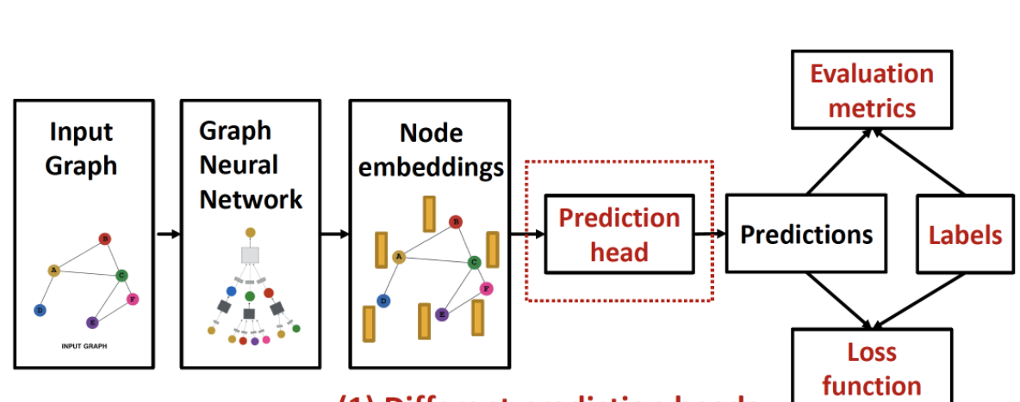
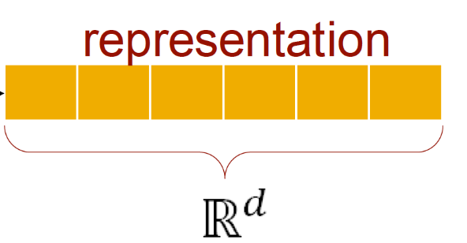
Spatio Temporal Modelling
Methods : 2. Obtaining latent representation using GCN operation over local neighbourhood
Ex: random walk algorithm, k-hop neighbourhood
General Vector Representation of Human Posture
Notes:
Neural inference modelling

Slide 28
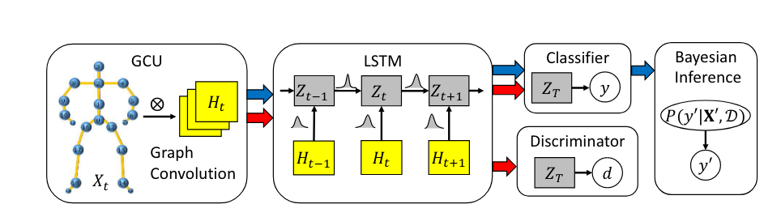
Spatio Temporal Modelling
Objective
Notes:
partitioning means the protocol on how to decide the neibourhood. rule for defining the neighbourhood receptive field

Slide 29
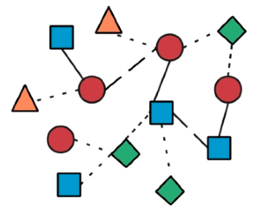
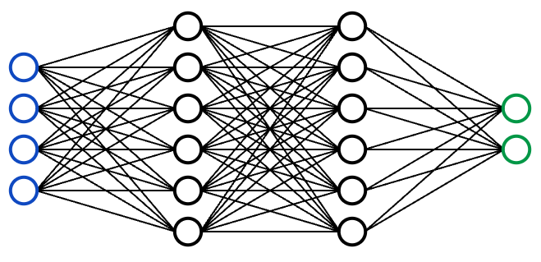



Knowledge Graph Modelling
Layer 1
Knowledge Graph
Layer 2
Experience Sampling
Data Processing
Accelerometer Data Processing
Computer Vision Data Processing
Notes:
A Knowledge Graph turns your data into machine-understandable knowledge.

Slide 30
Knowledge Graph Modelling
Stroke survivor
T₁
Impairment
I₂
Therapy activity
I₁
S₂
S₁
Knowledge Graph
Notes:
A Knowledge Graph turns your data into machine-understandable knowledge.

Slide 31
Knowledge Graph Modelling
What kind of insights can we generate from a knowledge graph
1. Which user profiles appear in the closer proximity/ neighbourhood?
Which of them are connected to each other
2. Link between an impairment and a user node means a particular user is having that impairment
Can predict the probability of having a particular impairment (Link prediction)
3 How is the graph evolving over time?
What insights does this evolvement provide?
4. What are the static interactions and dynamic interactions
Notes:
One way to perform general graph convolution is derived from spectral graph theory [30], which allows the graph convolution to be carried out in the spectral domain. The key operation is computing the graph Fourier transform, which is equivalent to computing an expansion of the graph with respect to the eigenfunctions of the graph Laplacian. Defferrard et al. [15] proposed to use an efficient approximation to compute the graph Fourier transform based on the Kth-order Chebyshev polynomial.
L = D-A
L is the bridge between the graph representation and the Linear algebra

Slide 32
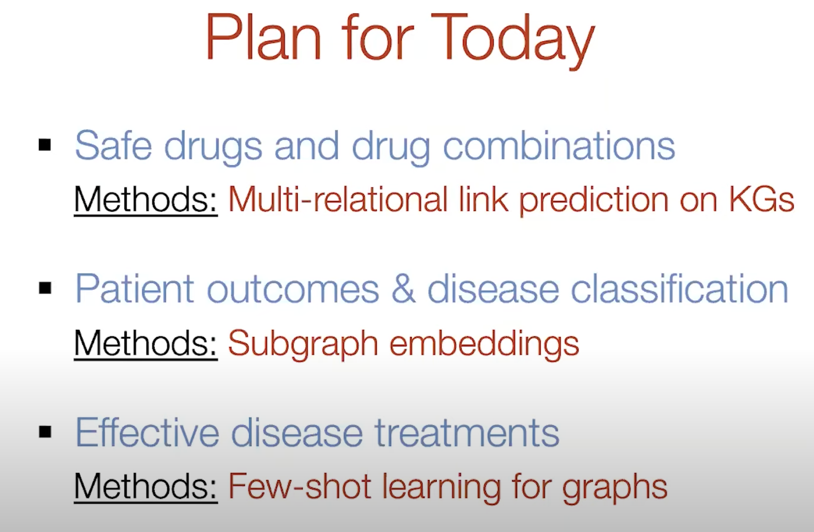

Slide 33
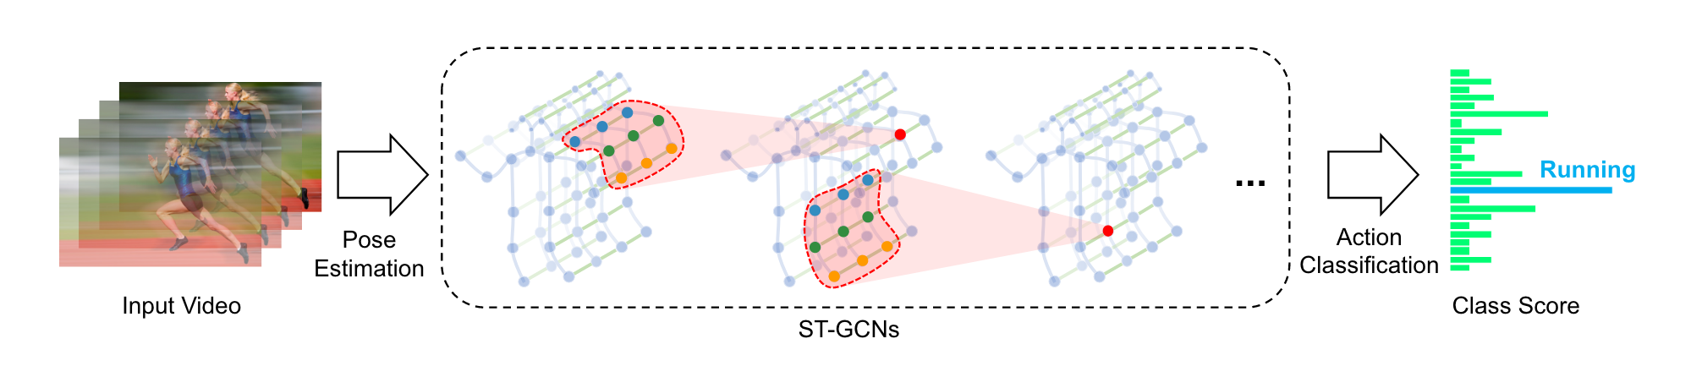
Spatio Temporal Modelling
Approach 1 : Modelling both aspects using GNN
ex: ST-GCN paper
Notes:
partitioning means the protocol on how to decide the neibourhood. rule for defining the neighbourhood receptive field

Slide 34
Computer Vision Test Activity - Analysis
Capacity
Quality
Accuracy
Movement Pattern
Position of wrist
Amount of Arm Use
Proportion of Arm Use
Symmetry of Arm Use
Smoothness
Speed
Limb position
Coordination
Movement Type
Reach
Functional grasp
Pincer grip
Positioning of arm and hand/fingers for task
Differentiate movements that involve objects

Slide 35
Project Flow
Data
Existing Video Data
Control Group Data
Feature Engineering
Extract interpretable info from video data
Use skeleton model
Alphapose
Openpose
OpenCV
MediaPipe
Optical Flow
SIFT for key point detection
Siamese network CNN
Knowledge Extraction
Insights
Set of valuable insights about the patient performance
Smoothness of movement
Accuracy of positioning
Dexterity
Coordination
limb position sense
Objectives
Standardise patient performance
Augment clinician with more insights
Domain Rule Mining
Trajectory analysis
Thresholding
Domain Rules to capture patient constraints
Unsupervised Learning Based Latent Space Representation
Segmentation
Profiling
Classification
Supervised Learning Based Extraction
CNN based models
XAI

Slide 36
Exploratory Analysis
Raw Data Extraction
Measurements
Analysis
Key Joint Coordinates
Speed
Traversed distance
Statistical measurements
Standard Deviation
Mean
AI based approach
Statistical Approach
Assessment Metrics
Capacity
Quality
Movement Pattern
Notes:
partitioning means the protocol on how to decide the neibourhood. rule for defining the neighbourhood receptive field

Slide 37
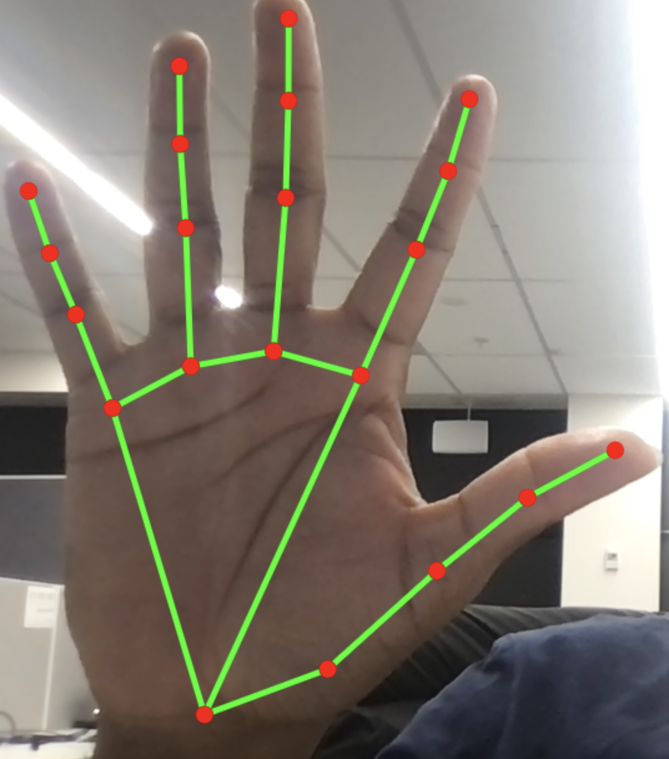
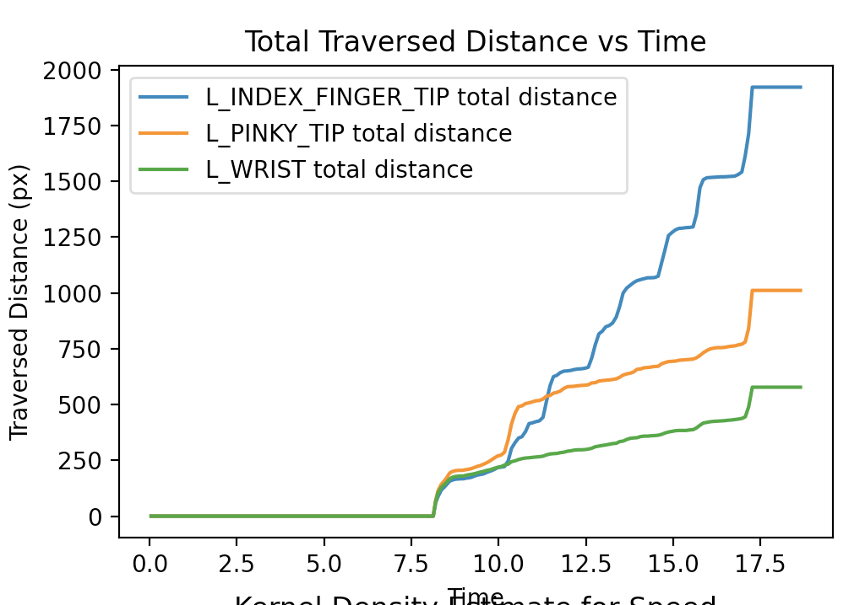
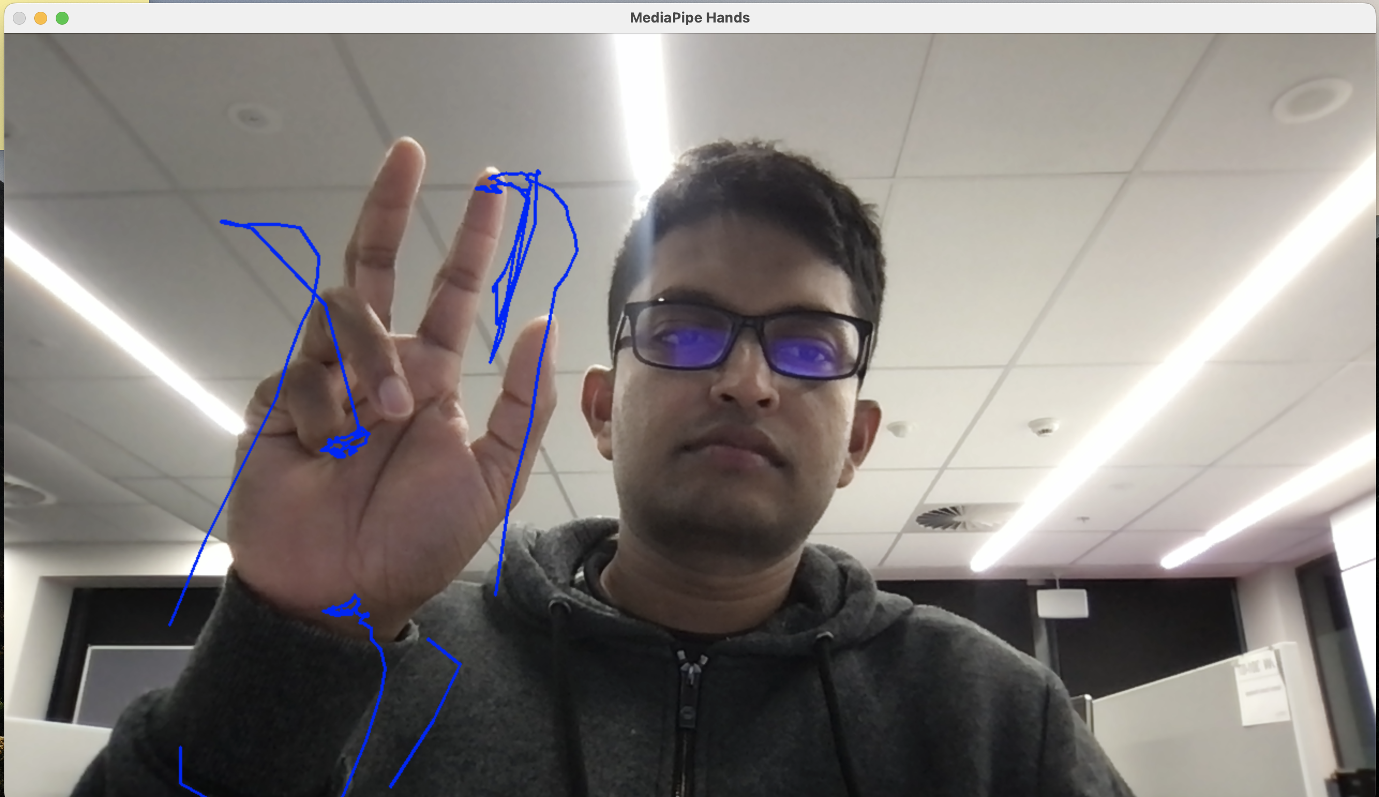
Exploratory Analysis
Raw data
Trajectory
Metrics Assessment
Notes:
partitioning means the protocol on how to decide the neibourhood. rule for defining the neighbourhood receptive field

Slide 38


Assessment Metrices
Speed graph
Traversed distance graph
Histogram for speed
Kernel density function for speed
Distribution measures (mean, min/max, Standard deviation)
Notes:
These measures are taken by locating finger joints at specific time point
But there are other measures we can consider
Angle
joint distance

Slide 39
Discussion points
Measuring capacity (Amount, proportion, symmetry etc.) of arm movement
Measuring quality (accuracy, smoothness, speed) of arm movement using more focused activity
ex: traversing a shape on the screen
Activity specific performance measures
Inter user vs intra user analysis
Analysis of statistical measures using ML techniques
Activity based analysis of anomaly detection
Notes:
If we have large amount of data for one activity, we can give more robust analysis of the user performance

Slide 40
Challenges
Sign language dataset is not complex enough to differentiate the model performance
limited datasets for the upper body movements
Notes:
Need to look into activity recognition in broader perspective

Slide 41

Evolution

Slide 42
Datasets
Simple activity classification : KTH data set
https://www.csc.kth.se/cvap/actions/
UCF data set
(https://www.crcv.ucf.edu/data/UCF101.php)
Kinect data set. (one label for segment)
https://towardsdatascience.com/downloading-the-kinetics-dataset-for-human-action-recognition-in-deep-learning-500c3d50f776
Most popular data set for benchmarkng
Toyota smarthome data set
https://project.inria.fr/toyotasmarthome/
Trimmed vs untrimmed versions available
Activity net Data set
https://youtu.be/x9AhZLDkbyc
https://prior.allenai.org/projects/charades
Notes:
Discuss about the challenges
temporal extent of an activity is ambiguous even for humans.
Current data set covered the same background and less clutter
In our approach we didn’t tag objects in the screen
Need to focus on localisation accuracy
Why need to go beyond
more complex, new challenges arose, including scale, background clutter, and action complexity, leading to improved algorithms
Currently most cases used tw streams networks for the analysis
(Spatial Stream + Temporal Stream )
Person based reasoning is impoartnat : persons movements make a important remark in the video
Which help for the accuracy of the

Slide 43
Potential extensions
Extend the classification to full-body activity classification
Change the data set to charades or ToyotaSmarthome
Identify elementary movement components
Add a component to identify objects in the frames
(this is in addition to the LSTM and GNN units for spatial and temporal feature capturing)
Notes:
Use the kinetics data set to validate the results
Use lagrangian approach in the algorithm
Try to get an encoding for the activity
Try to derive an alaphabet (atomic components for the action)
Derive algorithm to do segmentation of the action Segmentation

Slide 44
Existing approaches
Two stream networks
One stream for spatial feature recognition
One stream for capturing the temporal features
Each of the streams can use variety of architectures
In the current implementation, we have
GNN based component for spatial feature capturing
LSTM for capturing temporal features
Notes:
But still, we should stick to the exoskeleton extraction to capture the body movements

Slide 45
How to relate this paper to our original objective
How to identify multiple labels in a given action
Drinking water from a glass + compensation + trembling
These elementary features build up the alphabet for the entire activity spectrum
The absence or the presence of these elementary features will determine the quality of movements of the participant
Notes:
Try to identify anomalies new states activities may appear
(KTH [29]), sports (UCF101 [33]), ActivityNet Dataset
Charades (this one has more complex combinations)

Slide 46


Slide 47
Novelty
Using GNN based approach for capturing elementary activity components
Spatial capturing (GNN for human movement capturing + human object interaction capturing)
LSTM for temporality capturing

